Slide 1
High School Options
Dr. Ellison
Middle School Counselor
Ashley Park PreK-8 School

Slide 2
What are my choices in regards to high school?
Home School (based on where you live)
Student Reassignment Request
http://www.cms.k12.nc.us/cmsdepartments/StudentPlacement/Pages/RequestforReassignmentTransfer.aspx
Magnet Programs (based on where you live)
CMSchoice.org

Slide 3
What do I do if I want to attend my home school?
Academy of Information – Multimedia Webpage Design and Computer Programming
*cohort model – students are in all of the same core and
elective courses
Health Science Pathway – Biomedical Technology, Human Body Systems, Medical Interventions
Business and Entrepreneurship Pathway – Construction Tech, Cosmetology, Interior/Apparel Design
Hospitality and Tourism Pathway – Sports and Entertainment, Culinary Arts

Slide 4
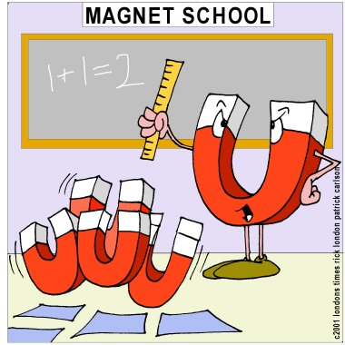
What are magnet programs and what are my options?
Magnet programs are educational programs that have specific focuses in addition to the traditional academic requirements.
Specific Focus + Academics
Students apply to the magnet lottery by choosing their top three choices. Students names are drawn semi-randomly with some weight given to student diversity.
Sibling guarantee – if a student has an older sibling who is currently enrolled in a magnet program and will be for the following school year, any incoming sibling will be guaranteed a spot in that same magnet program as long as both siblings live at the same home address.

Slide 5
West Charlotte IB Program
“The International Baccalaureate…works with schools, governments, and international organizations to develop challenging programs of international education and rigorous assessment. Our programs encourage students across the world to become active, compassionate and lifelong learners who understand that other people, with their differences can also be right.” (ibo.org)
Challenging work preparing you to be a global leader!
*To apply to IB, scholar must have scored a level 3, 4, or 5 on 7th grade
Reading EOG test and have counselor recommendation.

Slide 6
Harding IB Program
“The International Baccalaureate…works with schools, governments, and international organizations to develop challenging programs of international education and rigorous assessment. Our programs encourage students across the world to become active, compassionate and lifelong learners who understand that other people, with their differences can also be right.” (ibo.org)
Challenging work preparing you to be a global leader!
*To apply to IB, scholar must have scored a level 3, 4, or 5 on 7th grade Reading EOG test and have counselor recommendation.

Slide 7
Harding Institute of Technology
Automotive Technology – engine theory, automotive maintenance, brake repair, electrical systems, trouble shooting, safety, test equipment, small engine repair, and measuring.
Construction Technology – designing, planning, managing, building and maintaining built environments.
3D Design & Digital Manufacturing – animation concepts, 3D design techniques, unique projects with a variety of materials used to create computer and print designs.

Slide 8
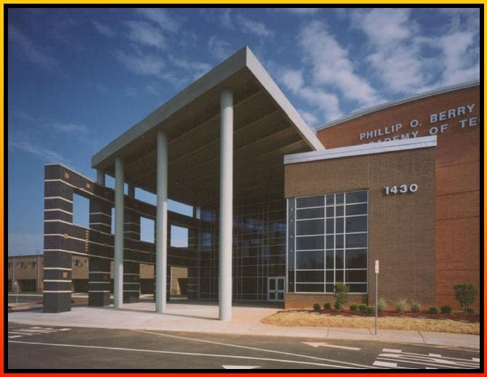
Phillip O. Berry STEM
Academy of Engineering – electronics, biotech,
computer manufacturing, engineering,
architecture
Academy of Information Technology –
programming, database, web design, digital
networks
Academy of Health Sciences – biotechnology, genetics, nursing, therapeutics, and diagnostics
*you do not choose a specific Academy until the end of your 9th grade year

Slide 9
Northwest School of the Arts
Ten Arts Areas of Focus:
Band Theatre
Orchestra Musical Theatre
Chorus Technical Theatre
Piano Costume Design
Dance Visual Arts
Audition / portfolio is required in order to apply. For information on this, see Dr. Ellison and refer to http://nwsa-auditions.weebly.com/
*audition slots are filling up fast so see Dr. Ellison ASAP if this is something you are interested in
*this school does not have athletics

Slide 10
Charlotte Engineering Early College
Ideal for scholars who have a desire to be in the field of engineering and have the self-motivation and maturity to be successful on a college campus. All elective courses are engineering courses.
Classes are split between a CMS building on a UNCC campus and actual college courses at UNCC. This school follows the UNCC calendar and not the CMS calendar. Also, this program goes from grades 9 – 13.
Sports available at home schools.

Slide 11
UNCC Early Educators Program
Ideal for scholars who have a desire to be in the field of education and have the self-motivation and maturity to be successful on a college campus.
Classes are split between a CMS building on a UNCC campus and actual college courses at the School of Education at UNCC. Also, this program goes from grades 9- 13.
*to play sports, you will have to ride a bus to your home school

Slide 12
Hawthorne Academy of Health Sciences
Prepares students for careers in medicine and the health and life sciences. This program provides an advanced curriculum with courses, partnerships, and activities that relate specifically to the medical field.
Access to college-level courses that lead to a post-secondary certificate, associate’s degree and/or industry certification through partnership with CPCC.
*to play sports, you will have to ride a bus to your home school although this school does have intramural sports.

Slide 13
Hawthorne Academy of Public Services
Prepares students for careers related to
Public Service / Safety
(law, government work, police/fire)
JROTC
(US Military services)
Arabic
(Middle Eastern and/or global affairs)
*to play sports, you will have to ride a bus to your home school although this school does have intramural sports.

Slide 14
Performance Learning Center
Non-traditional, blended learning high school academic program. Some courses are in person on the school campus and others are online. Rather than 8 courses a year, students take 10 courses a year.
There is a computer lab on campus for students who need access to computers to complete their online courses.
Ideal students for this program are self-motivated and accountable.

Slide 15
How to apply to magnet lottery
www.cmschoice.org
Complete application with top three choices
Lottery Application Round 1: November 30 – January 7 (ends at 10 pm)
*for your best chance of getting into the program you want, you should apply to Round 1. If you do not get your first choice, you should not reapply during Round 2, as this will bump you down on the waiting list from the Round 1 results.
LOTTERY RESULTS FROM ROUND 1 WILL BE MAILED TO HOME ADDRESS IN MID TO LATE JANUARY
*If you have questions about your lottery results, bring this into school for Dr. Ellison to review once you receive it
Lottery Application Round 2: January 18 – February 11
LOTTERY RESULTS FROM ROUND 2 WILL BE MAILED TO HOME ADDRESS IN LATE FEBRUARY
*If you have questions about your lottery results, bring this into school for Dr. Ellison to review once you receive it

Slide 16
Questions?
If you have questions, please contact Dr. Ellison at 980-343-6018 or meleahr.ellison@cms.k12.nc.us
CMS Magnet can be reached at 980-343-5030 or online at CMSchoice.org
- Information on magnet options and open house dates
- Key dates
- Transportation Zones (most Ashley Park scholars are in the Violet zone)

